Slide 1
Object Oriented Programming CS F213

Slide 2
Contents
Introduction
Exceptions
Types of Exceptions
Exception Handling
try-catch block
Examples
Finally block
Examples
Sources (Slides 3 to 16):
Cay Horstmann, Object Oriented Design & Patterns, John Wiley & Sons, 2006, 2nd Edition
https://cse.iitkgp.ac.in/~dsamanta/java
http://ramzi.ucoz.com/Java
https://www.geeksforgeeks.org/exceptions-in-java/
https://www.javatpoint.com/exception-handling-in-java#:~:text=What%20is%20Exception%20in%20Java,which%20is%20thrown%20at%20runtime.
https://www.tutorialspoint.com/java/java_exceptions.htm
https://www.geeksforgeeks.org/types-of-exception-in-java-with-examples/
https://beginnersbook.com/2013/04/java-exception-handling/

Slide 3
Introduction
Due to design errors or coding errors, our programs may fail in unexpected ways during execution, or may result in an abnormal program termination
It is our responsibility to produce robust code that does not fail unexpectedly.
Consequently, it is necessary to design error handling into our programs.
Error vs Exceptions
Error: An Error indicates serious problem that a reasonable application should not try to catch.
Exception: Exception indicates conditions that a reasonable application might try to catch.

Slide 4
Exceptions
An exception is an abnormal condition that can occur during the execution time of a program.
If these exceptions are not prevented or at least handled properly, either the program will be aborted abnormally, or the incorrect result will be carried on.
An exception can occur for many different reasons. Following are some scenarios where an exception occurs.
A user has entered an invalid data.
A file that needs to be opened cannot be found.
A network connection has been lost in the middle of communications or the JVM has run out of memory.

Slide 5
Types of Exceptions (1)
Checked exceptions are inherited from the core Java class Exception.
They represent compile time exceptions that are your responsibility to check.
Checked exceptions must be handled in your code. Otherwise, the compiler will issue an error message.
In the above example, if the file specified not found then program throw FileNotFoundException.
//Example 1: Checked exceptions
import java.io.File;
import java.io.FileReader;
public class FilenotFound_Demo {
public static void main(String args[]) {
File file = new File("E://file.txt");
FileReader fr = new FileReader(file);
}
}
C:\>javac FilenotFound_Demo.java
FilenotFound_Demo.java:8: error: unreported exception FileNotFoundException; must be caught or declared to be thrown
FileReader fr = new FileReader(file);
^
1 error

Slide 6
Checked exceptions
Exception | Description
ClassNotFoundException | Class not found.
CloneNotSupportedException | Attempt to clone an object that does not implement the Cloneable interface.
IllegalAccessException | Access to a class is denied.
InstantiationException | Attempt to create an object of an abstract class or interface.
InterruptedException | One thread has been interrupted by another thread.
NoSuchFieldException | A requested field does not exist.
NoSuchMethodException | A requested method does not exist.

Slide 7
Types of Exceptions (2)
Unchecked exceptions are runtime exceptions that result at runtime from conditions that you should not have allowed in the first place (inherited from RuntimeException).
In the above example, if we are trying to access 5th element program will throw ArrayIndexOutOfBoundsException.
//Example 2: Unhecked exceptions
public class Unchecked_Demo {
public static void main(String args[]) {
int num[] = {1, 2, 3, 4};
System.out.println(num[5]);
}
}
Output:
Exception in thread "main" java.lang.ArrayIndexOutOfBoundsException: 5 at Exceptions.Unchecked_Demo.main(Unchecked_Demo.java:8)

Slide 8
Unchecked exceptions
Exception | Description
ArithmeticException | Arithmetic error, such as divide-by-zero.
ArrayIndexOutOfBoundsException | Array index is out-of-bounds.
ArrayStoreException | Assignment to an array element of an incompatible type.
ClassCastException | Invalid cast.
IllegalArgumentException | Illegal argument used to invoke a method.
IllegalMonitorStateException | Illegal monitor operation, such as waiting on an unlocked thread.
IllegalStateException | Environment or application is in incorrect state.
IllegalThreadStateException | Requested operation not compatible with current thread state.
IndexOutOfBoundsException | Some type of index is out-of-bounds.
NegativeArraySizeException | Array created with a negative size.
NullPointerException | Invalid use of a null reference.
NumberFormatException | Invalid conversion of a string to a numeric format.
SecurityException | Attempt to violate security.
StringIndexOutOfBounds | Attempt to index outside the bounds of a string.
UnsupportedOperationException | An unsupported operation was encountered.

Slide 9
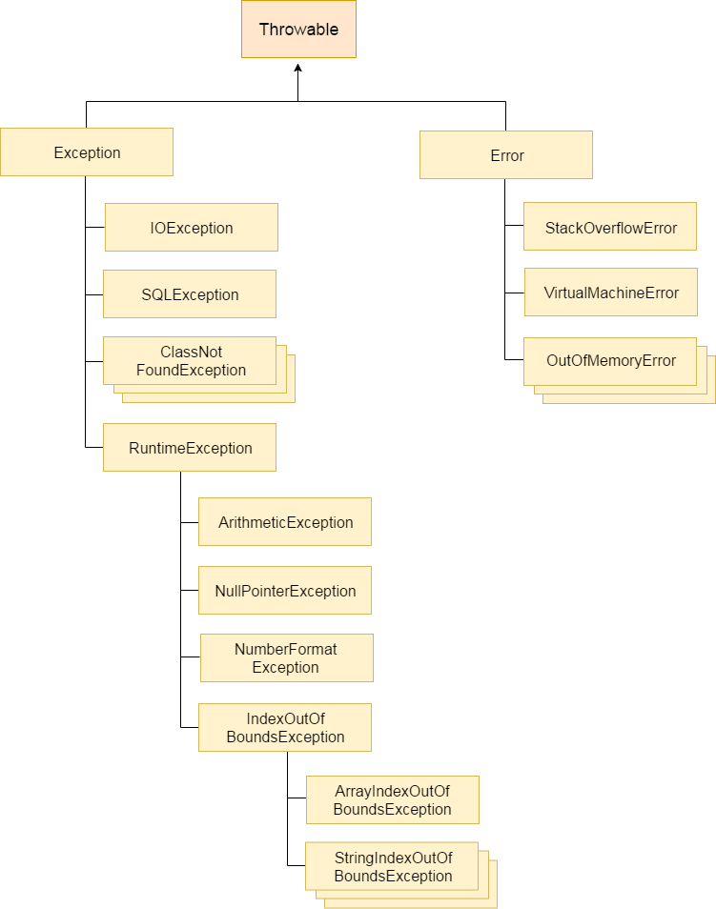
Types of Exceptions (3)

Slide 10
Exception Handling
Try-Catch Mechanism
Wherever your code may trigger an exception, the normal code logic is placed inside a block of code starting with the “try” keyword.
After the try block, the code to handle the exception should it arise is placed in a block of code starting with the “catch” keyword.
If none of the code inside the try block throws an exception, then the program skips the catch clause.
Syntax
try {
// Protected code
} catch (ExceptionName e1) {
// Catch block
}

Slide 11
Example
//Example 3: Try-catch mechanism
import java.io.*;
public class ExcepTest {
public static void main(String args[]) {
try {
int a[] = new int[2];
System.out.println("Access element three :" + a[3]);
} catch (ArrayIndexOutOfBoundsException e) {
System.out.println("Exception thrown :" + e);
}
System.out.println("Out of the block");
}
}
Output:
Exception thrown :java.lang.ArrayIndexOutOfBoundsException: 3
Out of the block

Slide 12
Example (Nested try-catch)
//Example 4: Multiple try-catch
public class MultipleCatchBlock1 {
public static void main(String[] args) {
try{
int a[]=new int[5]; a[5]=30/0;
}
catch(ArithmeticException e){
System.out.println("Arithmetic Exception occurs");
}
catch(ArrayIndexOutOfBoundsException e) {
System.out.println("ArrayIndexOutOfBounds Exception occurs");
}
catch(Exception e) {
System.out.println("Parent Exception occurs");
}
System.out.println(“Rest of the code");
}
}
Output:
Arithmetic Exception occurs
Rest of the code

Slide 13
Example (Nested try-catch)
//Example 4: Nested try-catch
public class Excep6{
public static void main(String args[]){
try{
try{
System.out.println("going to divide");
int b =39/0;
}
catch(ArithmeticException e)
{System.out.println(e);}
try{
int a[]=new int[5];
a[5]=4;
}
catch(ArrayIndexOutOfBoundsException e){System.out.println(e);}
System.out.println("other statement);
}catch(Exception e){System.out.println("handeled");}
System.out.println("normal flow..");
}
}
Output:
going to divide
java.lang.ArithmeticException: / by zero
java.lang.ArrayIndexOutOfBoundsException: Index 5 out of bounds for length 5
other statement
normal flow..

Slide 14
finally Block
A finally block contains all the crucial statements that must be executed whether exception occurs or not.
Syntax
try {
// Protected code
} catch (ExceptionType1 e1) {
// Catch block
} catch (ExceptionType2 e2) {
// Catch block
} catch (ExceptionType3 e3) {
// Catch block
}finally {
// The finally block always executes.
}

Slide 15
Example
//Example 5: Finally Block
public class Example
{
public static void main(String args[]) {
try{
int num=121/0;
System.out.println(num);
}
catch(ArithmeticException e){
System.out.println("Number should not be divided by zero");
}
/* Finally block will always execute
* even if there is no exception in try block
*/
finally{
System.out.println("This is finally block");
}
System.out.println("Out of try-catch-finally");
}
}
Output:
Number should not be divided by zero
This is finally block
Out of try-catch-finally

Slide 16
Example
//Example 6: Finally Block
public class ExcepTest {
public static void main(String args[]) {
int a[] = new int[2];
try {
System.out.println("Access element three :" + a[3]);
}
catch (ArrayIndexOutOfBoundsException e) {
System.out.println("Exception thrown :" + e);
}
finally {
a[0] = 6;
System.out.println("First element value: " + a[0]);
System.out.println("The finally statement is executed");
}
}
}
Output:
Exception thrown :java.lang.ArrayIndexOutOfBoundsException: 3
First element value: 6
The finally statement is executed

Slide 17
Thank you.

